Slide 1
Corporate Libraries: Adding Value in the Workplace
Joe Matthews
June 11, 2013

Slide 2
Think about
your library

Slide 3
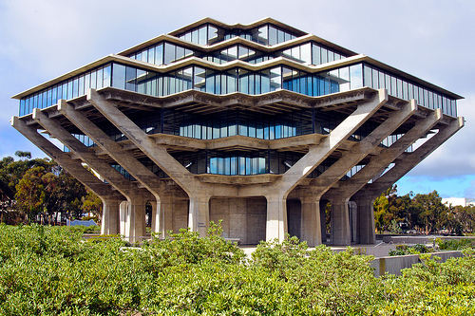
Notes:
Geisel Library at UCSD

Slide 4
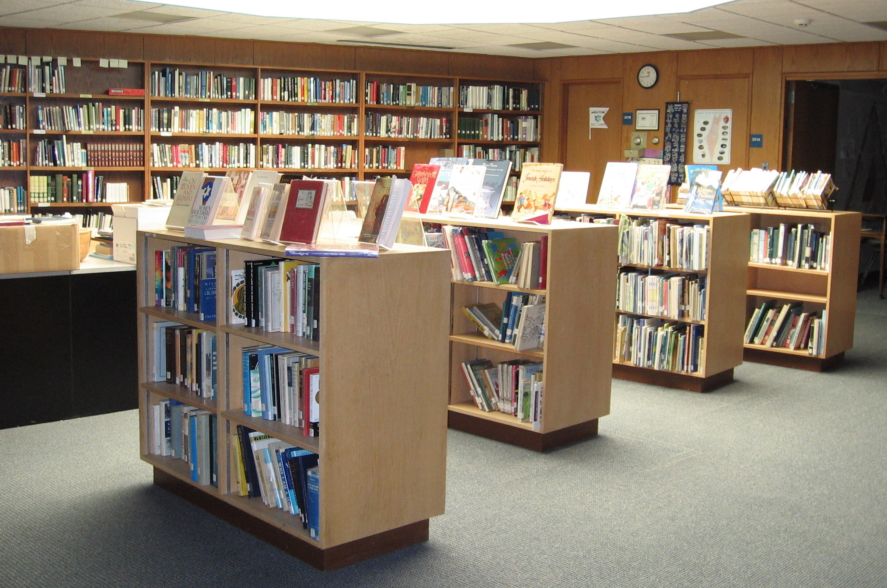

Slide 5
THEN:
Library center
of the
universe
Notes:
The user built workflow around the library

Slide 6
Resources scarce

Slide 7
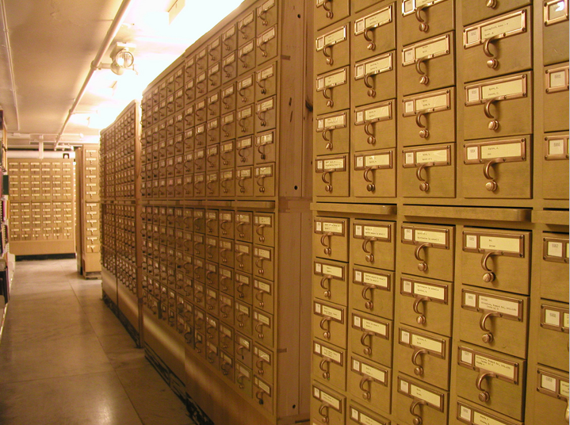
Integrated around the collection
Services

Slide 8
hierarchy
Everything in its place
hierarchy

Slide 9
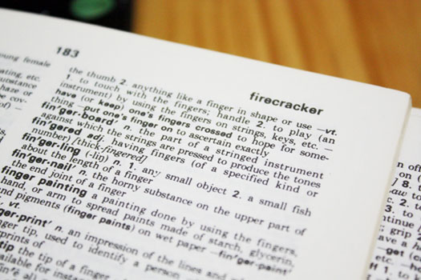
hierarchy
Controlled vocabulary

Slide 10
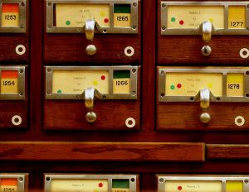
hierarchy
Complex systems

Slide 11
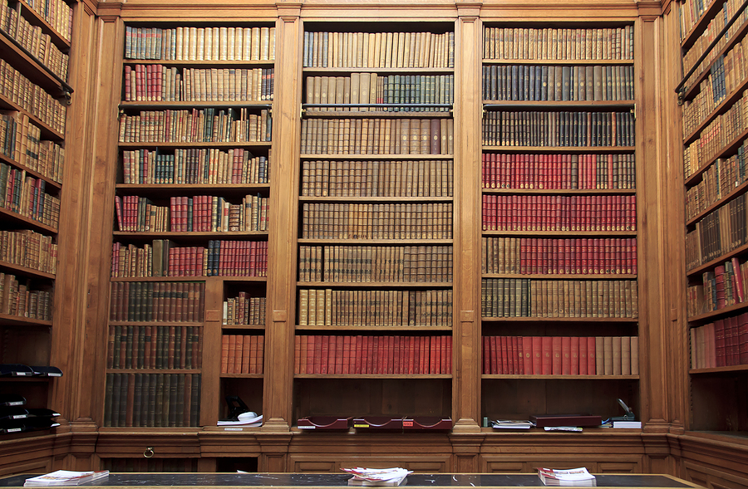
hierarchy
Constrained by a physical world

Slide 12
tradition
Collective wealth held hostage
Notes:
There is a collective wealth held hostage by redundant operations and collections in academic libraries

Slide 13
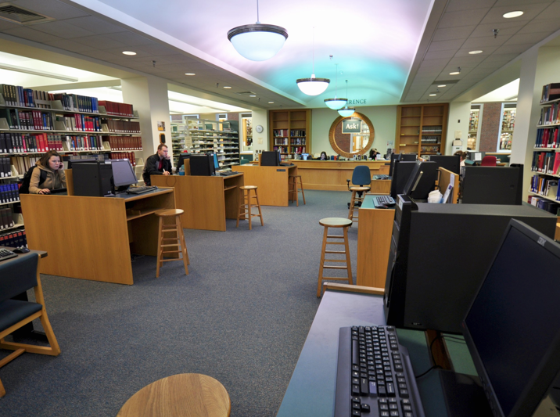
Attention abundant

Slide 14
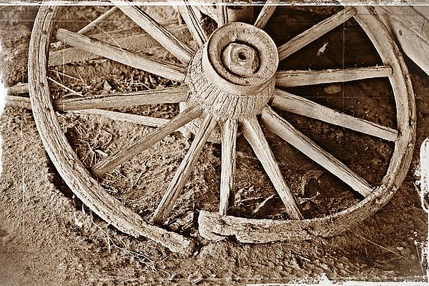
Notes:
Library as wagon wheel – the center of the universe – rather than a network

Slide 15
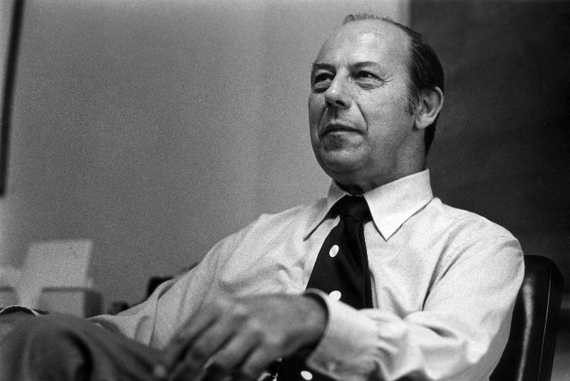
Robert Taylor
Notes:
Value-Added Processing in Information Systems- 1986

Slide 16
Customer Criteria for Assessing Value
Customer Criterion | Value Added by the Service
Ease of use | Browsing, formatting, mediation service, orientation service, ordering, physical processing
Noise reduction | Access (identification, subject description, subject summary), linkage, precision, selectivity
Quality | Accuracy, comprehensiveness, currency, reliability, validity
Adaptability | Closeness to problem, flexibility, simplicity, stimulatory
Time savings | Response speed
Cost savings | Savings, increased revenues, grow market share

Slide 17
Value-Added Spectrum
Action
Matching goals
Compromising
Bargaining
Choosing
Decision Processes
Productive Knowledge
Presenting
- Options
- Advantages
- Disadvantages
Judgmental Processes
Informing Knowledge
Separating
Evaluating
Validating
Comparing
Interpreting
Synthesizing
Analyzing Processes
Information
Grouping
Classifying
Relating
Formatting
Signaling
Displaying
Organizing Processes
Data

Slide 19
Nature of Information is Changing
Information
was ….
Information
is ….
Scare, controlled
Expensive
Shaped by elites
One-way, mass consumption
Slow moving
External to our worlds
All around us
Cheap or free
Shaped by consumers
Designed for sharing, participation & feedback
Immediate
Embedded to our worlds

Slide 20
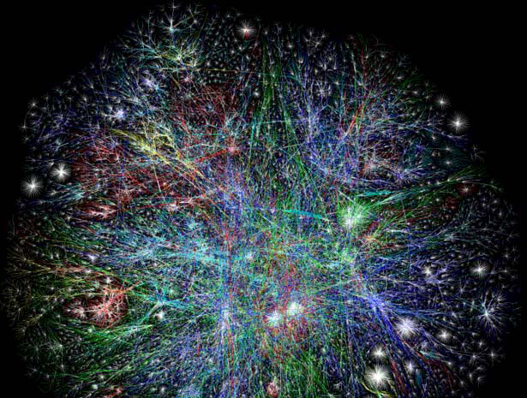
Customers
Network scale
Notes:
What has changed?
The library is an institution scale
while many of its users operate at network scale

Slide 21
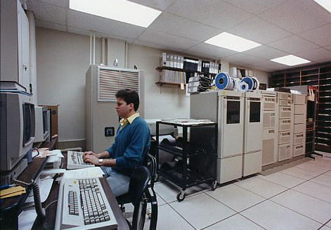
Redundant local infrastructure
Notes:
What has changed?
Libraries are redundantly managing local infrastructure
which creates little distinctive value.

Slide 22
NOW
Notes:
Now: Attention scarce, resources abundant
Now: The library must build its services around user workflow
Now: low transaction costs distribute activities across the network
Now: moving apart in network environment
(Dempsey, 2008)

Slide 23
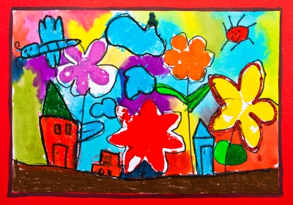
Customers
The scarce factor is not information; it is attention and especially human attention.
Herb Simon
Notes:
Assisting customers by reducing or eliminating the need for access and retrieval so that they can making better decisions
Satisficing

Slide 24
People come to us PLUS we go to people
The library as
place becomes
the library as
placeless
resource

Slide 25
Ways to
Add Value
Notes:
The 5 Cs – Community, Content, Context, Connection, Co-Creation

Slide 26
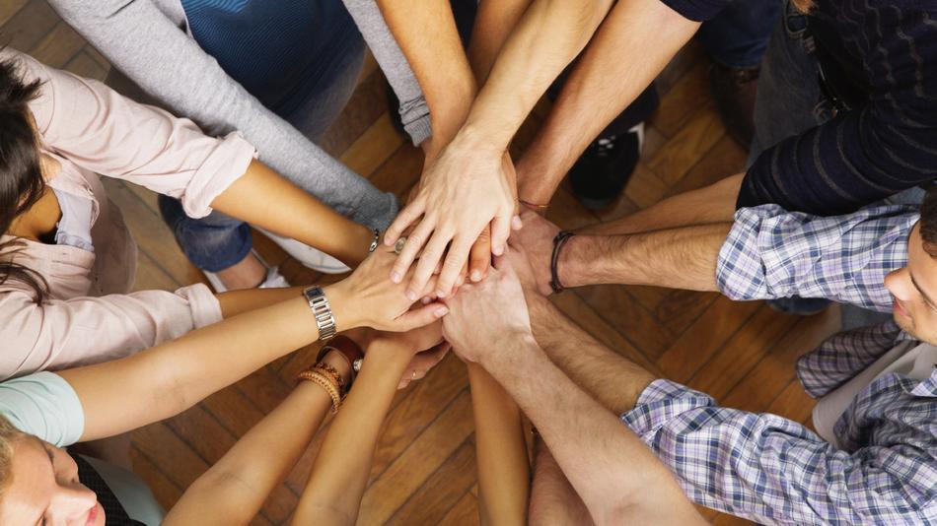
Community
Notes:
Reach more of your community

Slide 27
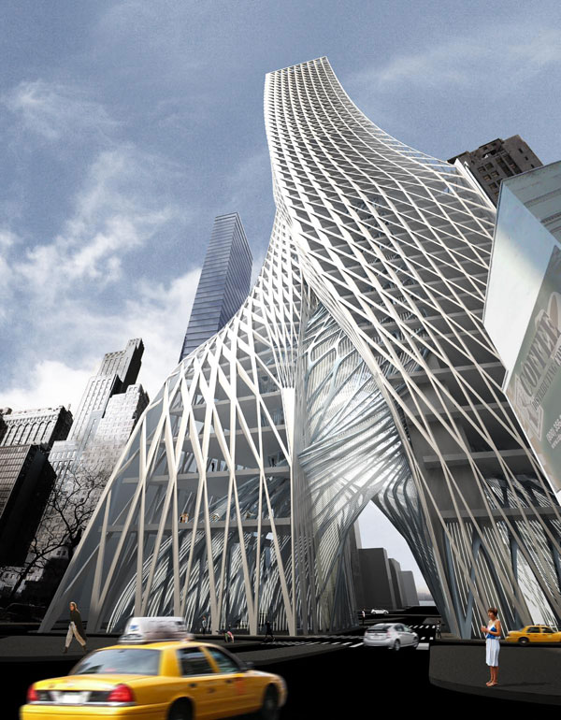
Building
New Virtual
Communities

Slide 28
Notes:
The traditional content of the library is increasingly becoming available from several competitive sources. Google Books, Google Scholar, Internet Archive,
Libraries can provide access to unique content in the form of historical photos, diaries, movies, and so forth.
Many libraries have digitized some of their unique “special” collections and made them available on the Net.
Should a library digitize special collections on their own? Expertise, equipment, space, and …
Consortium, outsource

Slide 29
Notes:
2nd C - Context

Slide 30
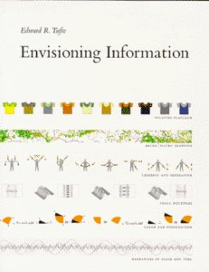
Edward Tufte & Richard Wurman

Slide 31
L ocation
A lphabetical
T ime
C ategory
H ierarchy
Notes:
Richard Wurman – 5 ways to organize information
Flickr Photo by tine negus Latch

Slide 32
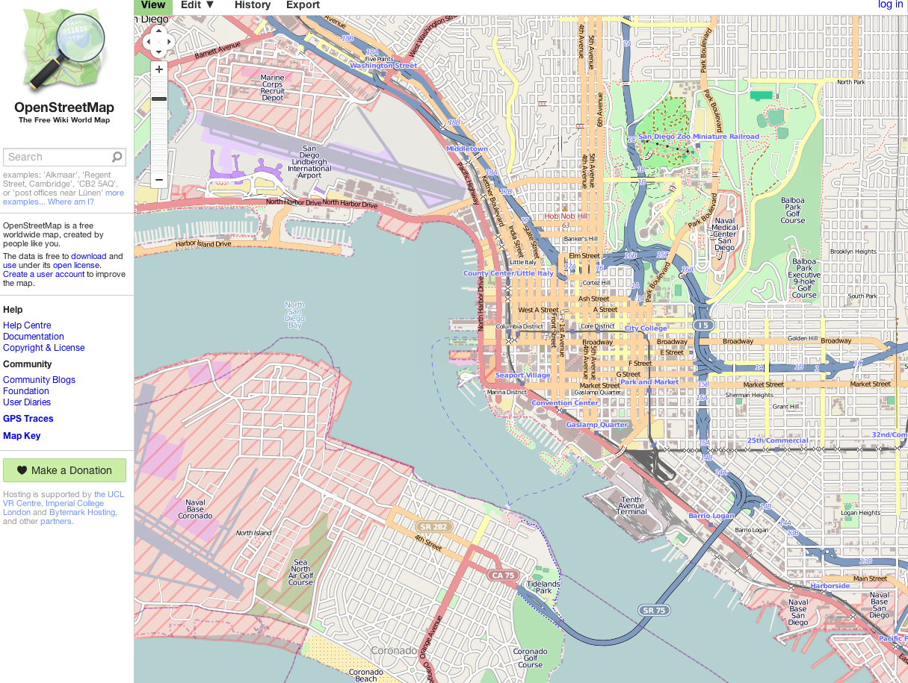
Location
Notes:
OpenStreetMap.Org
OpenMaps.EU, Open.MapQuest.Com, OpenCycleMap.Org, and others

Slide 33
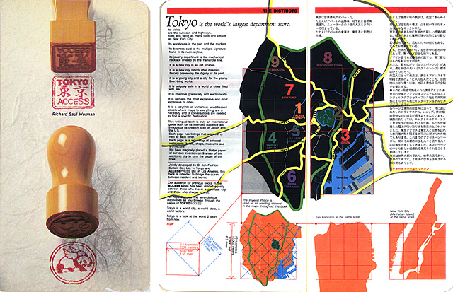

Slide 34
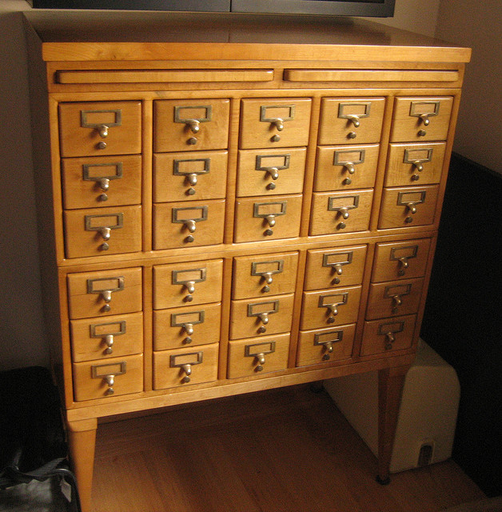
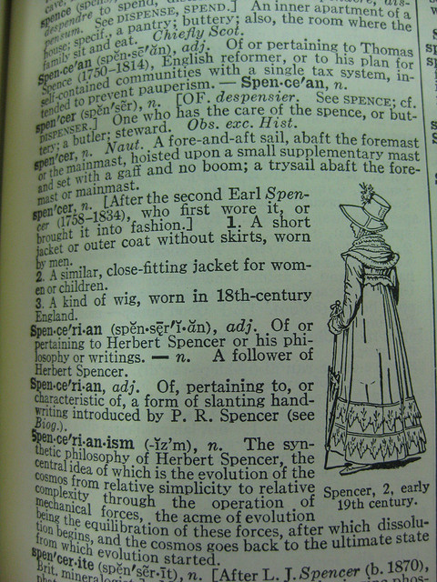
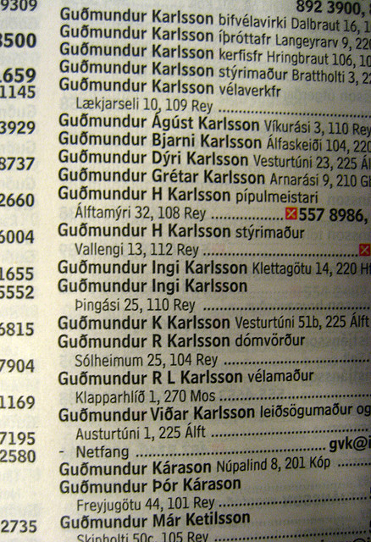
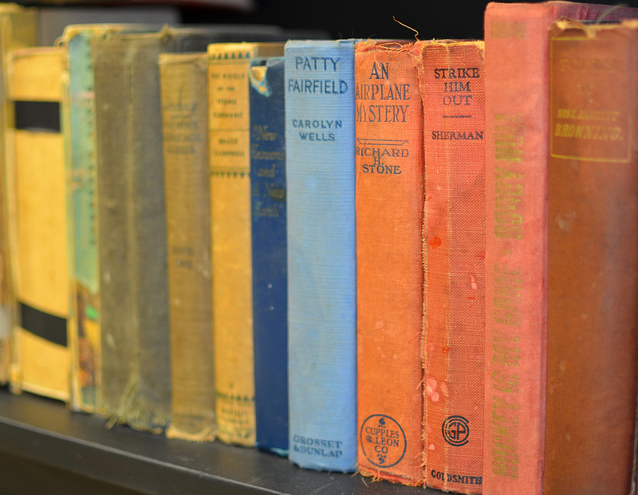
Alphabetical Order
Notes:
Alphabetical order is perhaps the most frequently used method for organizing information, especially in libraries. Consider the fiction is organized in most public libraries (alphabetical by author’s last name), words in a dictionary, a telephone book, an index, and so forth.
Subject headings in a catalog
Flickr photo by madeBYwake library card catalog
Flickr photo by noricum Dictionary
Flickr photo by termix Icelandic Telephone book

Slide 35
Time
Notes:
Time works especially well when a series of events have happen over time.
Thus, exhibitions, museums, histories utilize timelines to help orientate the visitor.
Time is a well-recognize framework from which to observe and compare changes.
Timelines are particularly useful for studying history, as they convey a sense of change over time.
Wars and social movements are often shown as timelines. Timelines are also useful for biographies. Examples include:
Chronology of Shakespeare's plays
Timeline of the American Civil Rights Movement
Timeline of European exploration
Timeline of Solar System exploration
Timeline of United States history (1930-1949)
Timeline of World War I
Open source timeline – timelineJS http://timeline.verite.co/
Another open source timeline http://www.simile-widgets.org/timeline/

Slide 36
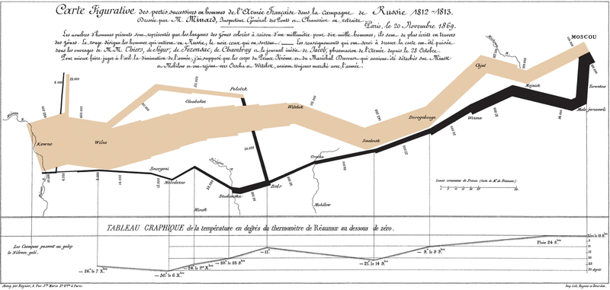
Napoleon's March
Notes:
http://en.wikipedia.org/wiki/File:Minard.png

Slide 37
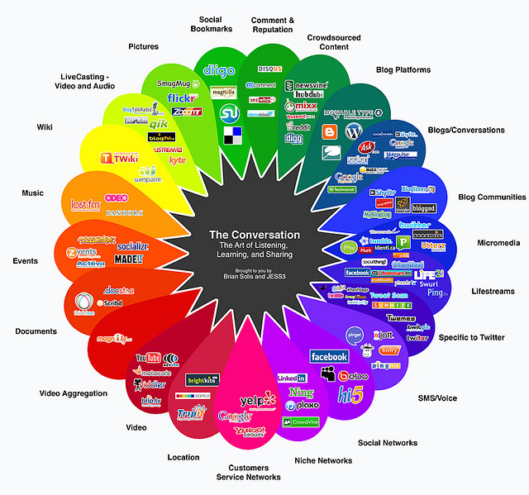
Category
Notes:
Category is another effective means of organizing information or physical objects.
Types of materials usually organize retail stores and libraries.
Category is often reinforced by the use of colors.
Flickr image by Deciter Interactions Social Media Categories

Slide 38
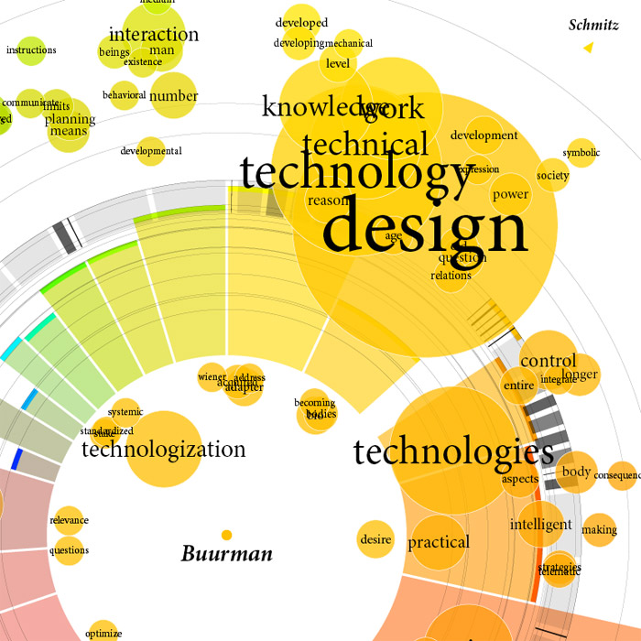
Notes:
Showing categories and their relationships to one another

Slide 39
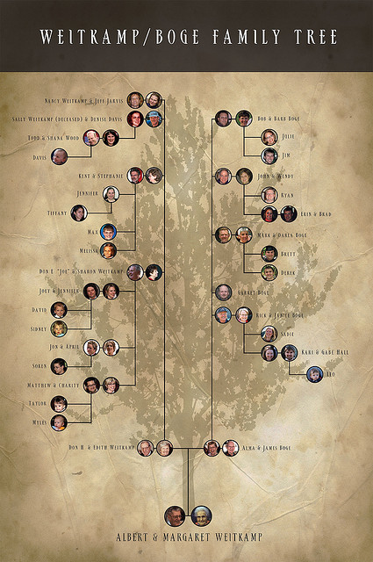
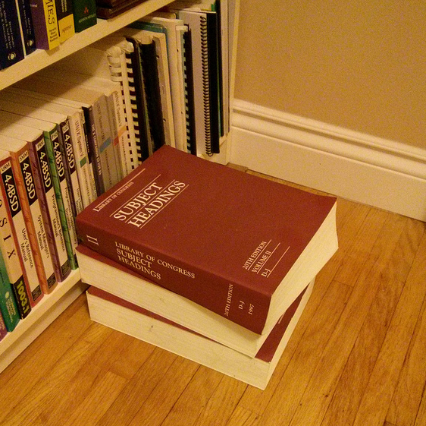
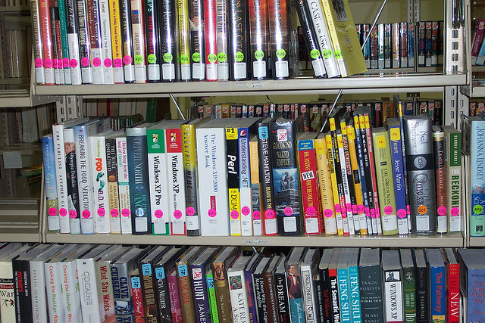
Hierarchy
Notes:
Library Subject Headings
Flickr photo by djfiander H365/17 having my own personal copy of the LCSH amuses me
Flickr photo by Phil Shirley Books
Family trees Flickr photo by mweitkamp

Slide 40
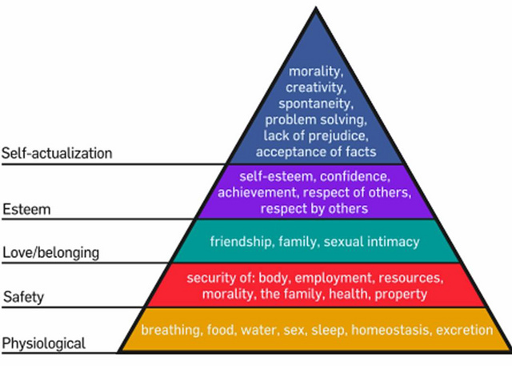
Hierarchy
Notes:
Maslow Hierarchy organizing items from least expensive to most expensive, by order of importance, by magnitude from small to large, and numerical order.
A synonym for hierarchy is continuum when comparing things across a common measure – highest to lowest, best to worst, first to last.
Hierarchy is created through superordinate/subordinate or parent/child relationships.
We typically look at this type of information from left to right or top/down organization.
Flickr image by aymansarhan Maslow Hierarch of Needs

Slide 41
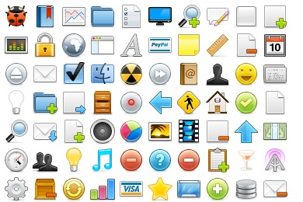
Icons or Images
Notes:
Application icons www.iconarchive.com

Slide 42
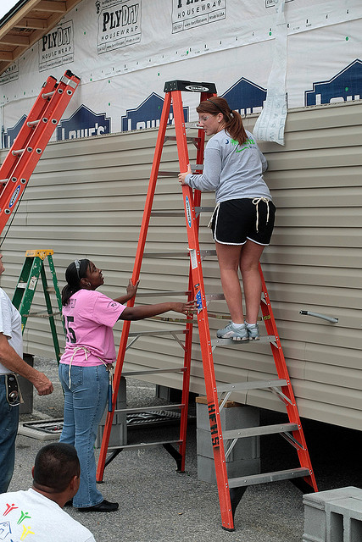
Task or Service
Notes:
Flickr photo by USC Upstate Habitat for Humanity of Spartanburg

Slide 43
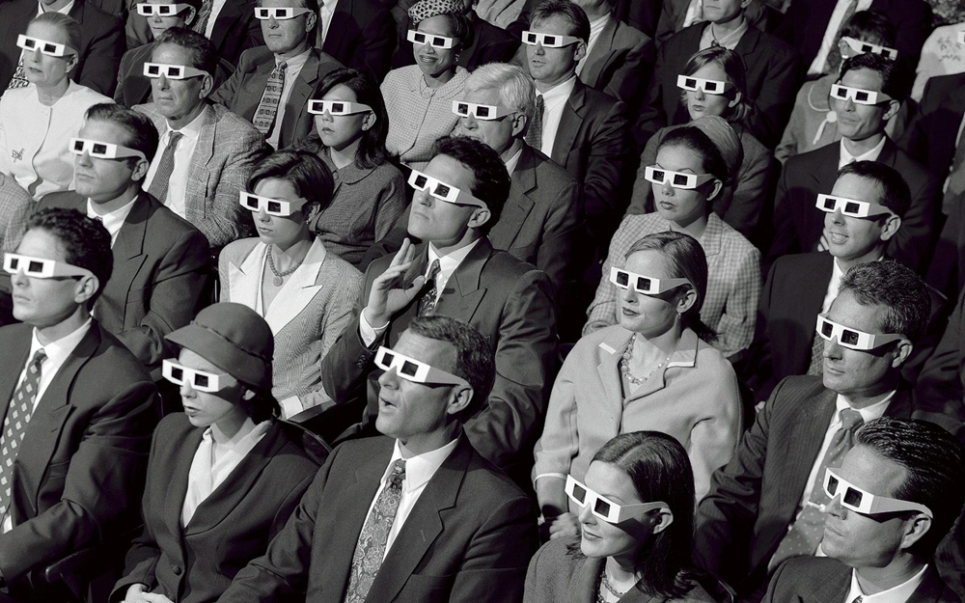
Audience
Notes:
Organizing content based on your audience’s needs is a best practice
by task or service
Google images Audience wererolling.blogspot.com
You should use various means to analyze your audience, including:
Web analytics: With appropriate steps to protect privacy, Google Analytics and similar tools can give you a wealth of information about the people who use your website and the tasks they try to complete on your site. For example, how did they get there? What page did they first visit? Where did they go from that page? If they used your site search, what page were they on at the time? What terms did they use to search for what they were looking for?
Usability testing: Usability tests begin with a short series of questions about the participants’ background, needs, and familiarity with your website. Don’t miss this opportunity to learn from a real site visitor. Use open- as well as closed-ended questions to get to know them well. Learn more at the Usability Testing section at Usability.gov or our own Usability Testing page.
Customer satisfaction surveys: You can include questions to ask about your visitors’ occupations, why they come to your site, and what they want to accomplish. Read more about Customer Satisfaction Metrics.
Focus groups: Even with a few participants, a focus group can tell you what some typical visitors think about your site. Use focus groups to get information about general impressions and ideas for new and useful features. Don’t ask participants what they would do. Instead, use usability testing to get that answer.
Market Research: Many polling firms, media research companies, and nonprofit and academic research centers collect and analyze data about web users and their behavior on the web. See the section below for a list of those organizations.
Web server logs: Server logs can provide some data about your visitors, such as country of origin.
Email, phone calls, letters, and other contacts with the public: Find out the top requests and complaints coming into your agency by phone, email, and in-person service centers. If you have a central agency phone number (such as a 1-800 number), get regular reports from the operators to find out what your audience is asking for and who they are.
Anticipating customer needs: To determine what your customers want on common types of web pages, review Users' Questions and Guidance for Common Types of Web Pages (PDF, 88 KB, 8 pages, April 2009).
Input from other web content managers: Touch base with your colleagues at other agencies. Are you serving the same audiences? If so, work with them to make sure your websites complement, but don't duplicate, each other.
Search data: Find out the terms your visitors are typing into your search engine. Determine which types of users they map to. Make sure the terms they use are the same terms and labels you’re using on your site. And make sure the most requested items are easily accessible from your homepage.
Commercial products that provide demographic data about your website visitors: There are a variety of products that will collect and analyze demographic data about your website visitors.

Slide 44
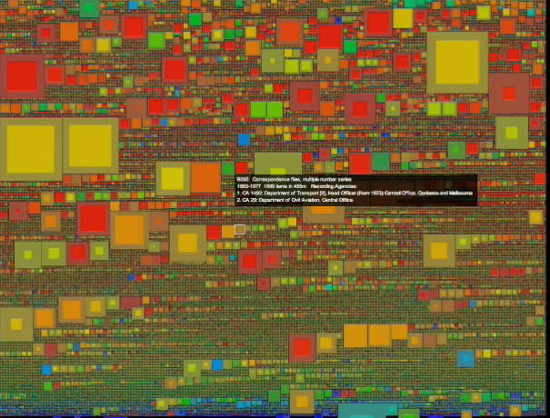
Notes:
National Archives of Australia

Slide 45
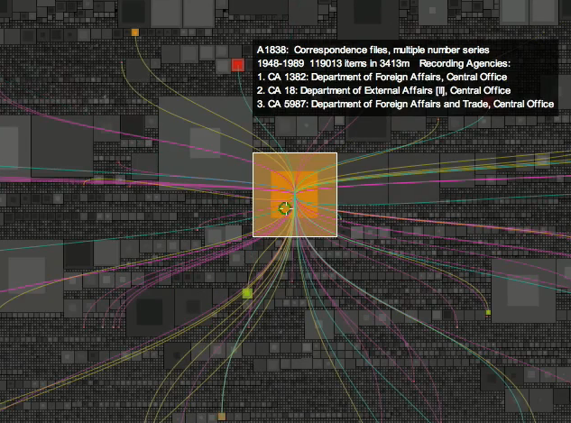
Notes:
Adding more context by showing the links between various segments of the collection

Slide 46
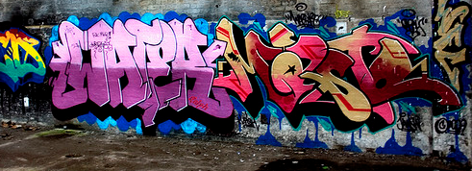
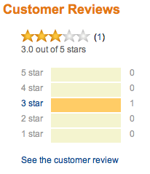
People are Involved!
Notes:
Tagging Flickr photo by ralph58 Tag Center
Reviews
Ratings Flickr photo by MoHDI harsh_review

Slide 47
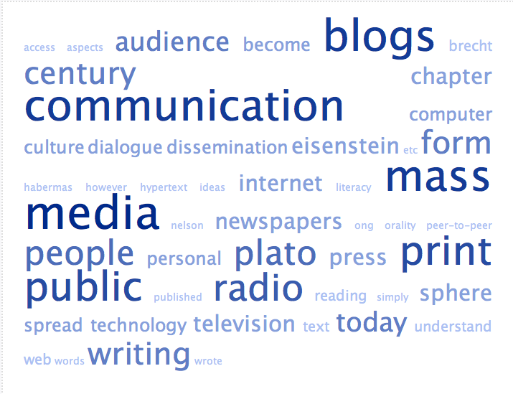
Notes:
Tagging

Slide 48
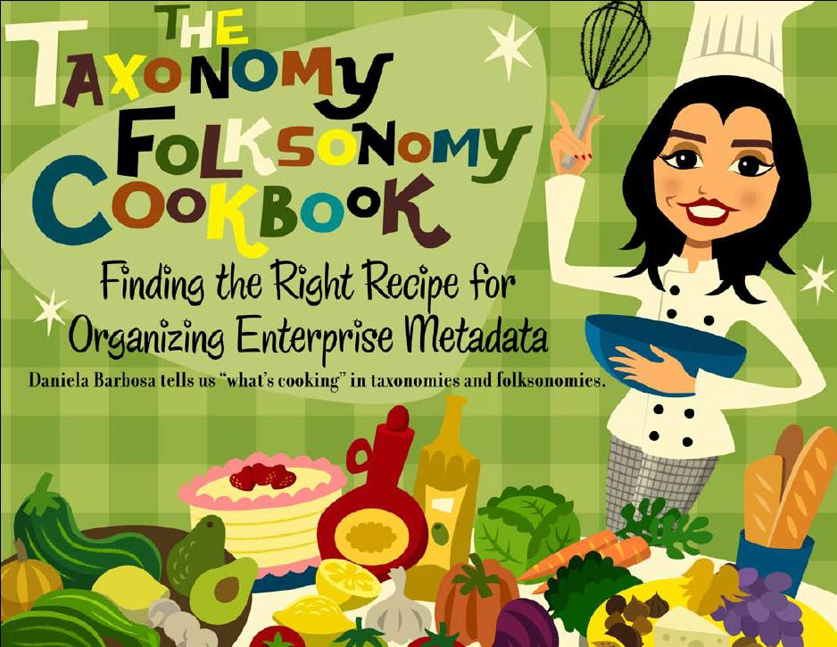
Notes:
Tap people power

Slide 49
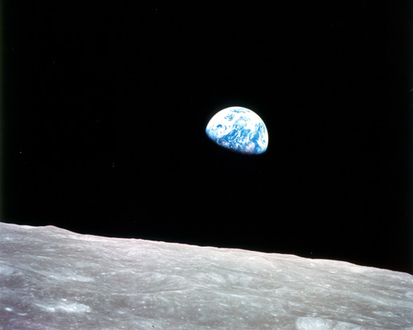
Contextualization
Notes:
Contextualization – adding contextual knowledge to objects by telling stories, identifying the names of people, places and dates.
Image of the Earth rising over the Moon from Apollo 8
This view of the rising Earth greeted the Apollo 8 astronauts as they came from behind the Moon after the lunar orbit insertion burn. Earth is about five degrees above the horizon in the photo. The unnamed surface features in the foreground are near the eastern limb of the Moon as viewed from Earth. The lunar horizon is approximately 780 kilometers from the spacecraft. Width of the photographed area at the horizon is about 175 kilometers. On the Earth 240,000 miles away, the sunset terminator bisects Africa. Credit: NASA
The three-astronaut crew — Commander Frank Borman, Command Module Pilot James Lovell, and Lunar Module Pilot William Anders — became the first humans to travel beyond low Earth orbit, the first to see Earth as a whole planet, and then the first to directly see the far side of the Moon. The 1968 mission, the third flight of the Saturn V rocket and the first manned launch of the Saturn V, was also the first manned launch from the John F. Kennedy Space Center, Florida, located adjacent to Cape Canaveral.
Orbited the moon 10 times and a Christmas Eve television broadcast in 1968

Slide 50
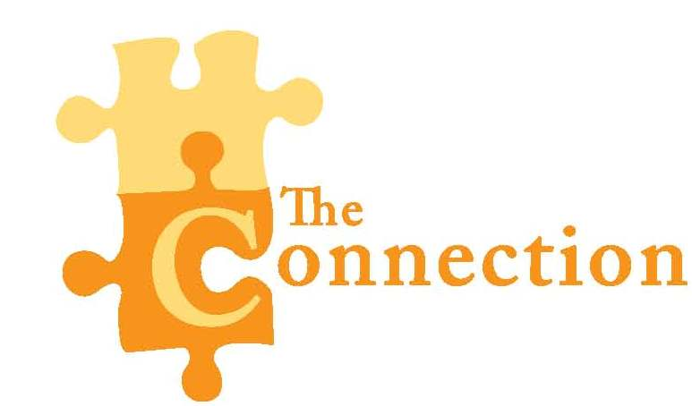
Notes:
The 4th C – Connection
Embedded librarian
Wandering librarian
Team member
Understand the needs of the user better
Better understand how to communicate with the user

Slide 51
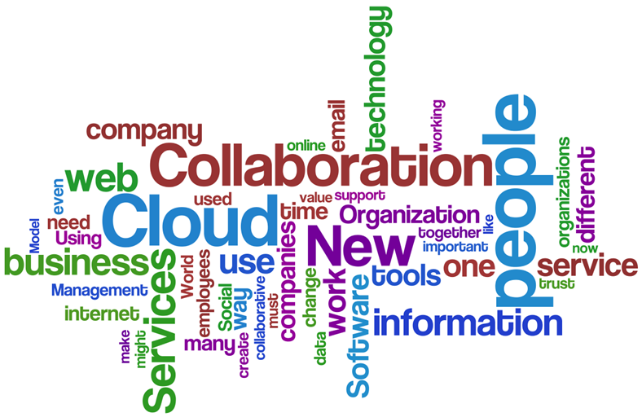
Notes:
The 5th C – Collaboration

Slide 52
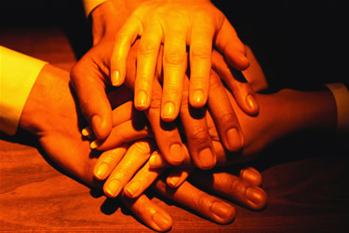
Club of experts
Crowd of people
Coalition of parties
Community of kindred spirits

Slide 53
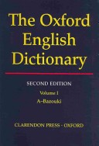
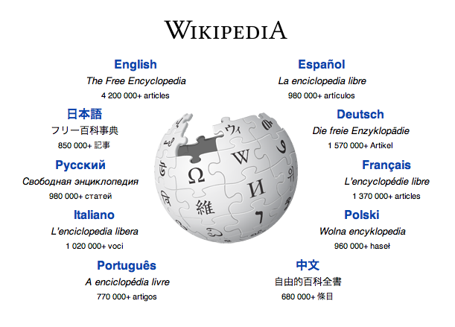
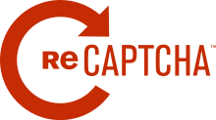
Crowdsourcing
Notes:
People seem to get involved in a crowdsourcing project for the underlying immaterial reward, combining egocentric and altruistic factors.
Simon Winchester’s The Story of Everything – history of the OED
Crowd funding – KickStarter
Microwork – Mechanical Turk
Inducement prize – Netflix (10%); DARPA balloon experiment – 10 balloons (MIT less than 9 hours);
Implicit crowdsourcing – reCAPTCHA ensure a response is from a human being anti-spam
Citizen science – GalazyZoo – 170,000 volunteers, over 50,000,000 classifications – type of galaxy
Key ingredients in this mix include:
satisfying curiosity,
seeking challenges,
earning status and getting recognition within a community,
intellectual enrichment,
belonging to a group,
working for the public good, or
simply having fun.
Collaborators not users, contribute to real research, don’t waste people’s time

Slide 54
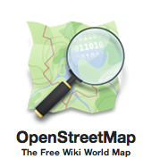
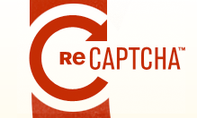
Notes:
All of these sites get 1 MILLION hours / year of community effort

Slide 55
Libraries Using Crowdsourcing
Notes:
Transcription – while reading digitized materials people can transcribe the content so that it can be then included in a full text index of the library’s content.
Noteworthy projects include the National Library of Australia’s Trove site where people can transcribe early newspapers,
the National Library of the Netherlands,
the New York Public Library’s project to transcribe historical restaurant menus,
the National Library of Finland’s Digitalkoot, and several others.

Slide 56
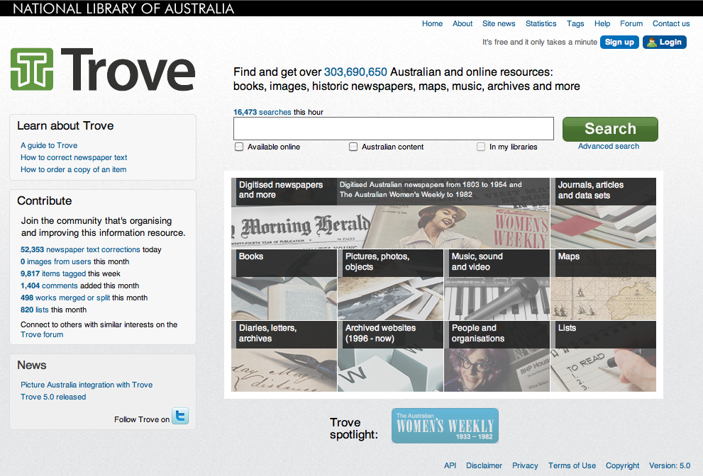
Transcription
Notes:
Since 2008, 93,072,150 corrected lines of newspapers has occurred (as of April 2013)

Slide 57
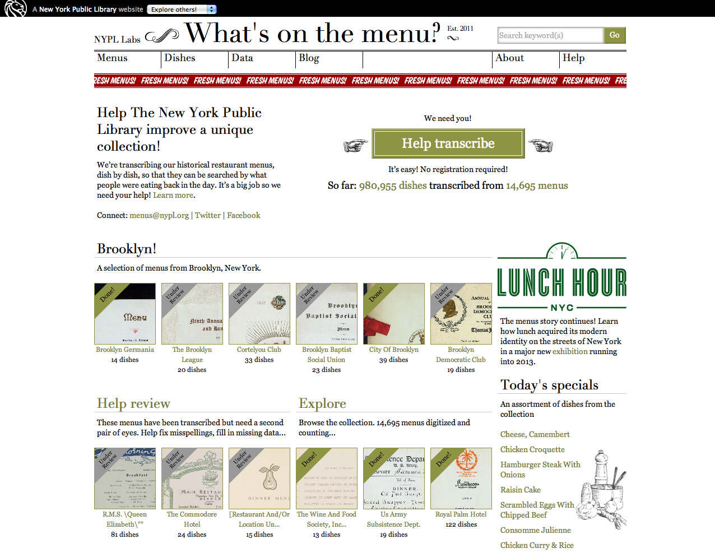

Slide 58
Notes:
University of Iowa libraries

Slide 59
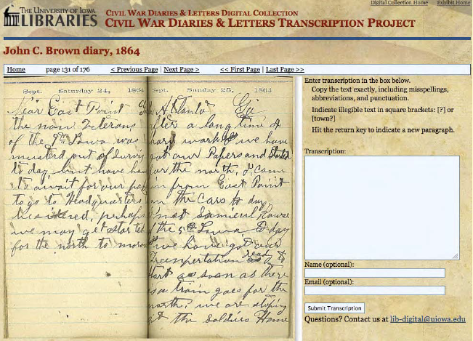

Slide 60
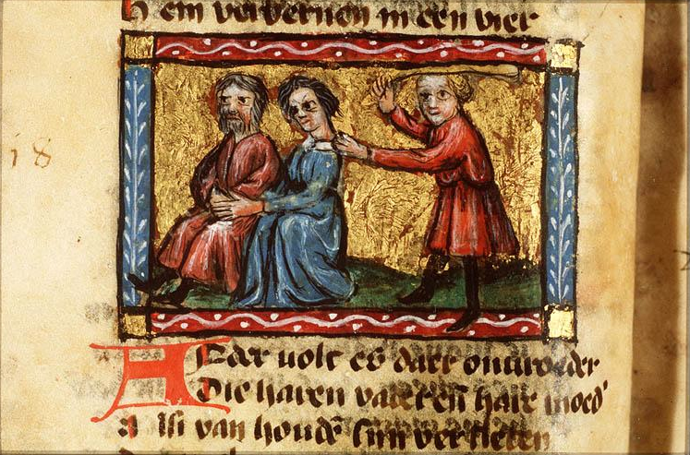
Notes:
National Library of the Netherlands

Slide 61
Notes:
Indirect transcription

Slide 62
Notes:
DigitalKoot = Digital Volunteers Digitized more than 5 million pages of 18th to 20th century texts
Mole Hunt – are two words the same
Mole Bridge – Spell correctly the words on the screen – to build the bridge

Slide 63
Georeferencing
Notes:
Georeferencing – allows people to “anchor” or align one or more points of a digitized historical map with a current map.
Users can then see all of the maps that encompass a particular place.

Slide 65
Notes:
A plan of the town of St John's on the island of Antigua, drawn in 1788 by Surveyor General John Killian.
Overlaid on modern mapping online, image [copyright] 2013 Digital Globe, [copyright] 2013 Google.

Slide 67
Notes:
Edinburgh City Library – Edinburgh Reads and Around the World in 80 DIs

Slide 68
Complementing Collections
Notes:
Complementing collections – active pursuit of additional objects and content to be included in a (Web) exhibit or collection.

Slide 69
Classification
Notes:
Classification – gathering or correcting descriptive metadata related to objects in a collection using
social tagging, user generated metadata, and folksonomies.
Civil War Faces, Library of Congress (USA) The Library of Congress is calling on the crowd to help identify people
and photographers in the Liljenquist Family collection of ambrotype and tintype photographs from the Civil War.

Slide 70
Co-Curation
Notes:
Co-curation – using inspiration and expertise of non-professional curators to create (Web) exhibits.
Engaging a community so that they become excited about the library and its services
can lead to collaboration so that the experience for everyone is greatly enriched.

Slide 71
Notes:
Pinterest – Civil War

Slide 73
Community
Content
Context
Connection
Collaboration

Slide 74
Notes:
Why Engage our …

Slide 75
Notes:
Achieve goals the library would never have the time, money or staff resources to achieve on its own

Slide 76
Notes:
Achieve goals in a much faster timeframe than the library would be able to achieve if it worked on its own

Slide 77
Notes:
Actively involving and engaging the community with the library and its other users and collections

Slide 78
Notes:
Tap into the knowledge, expertise, and interest of the community

Slide 79
Notes:
Adding value to a resource by the addition of comments, tags, ratings, reviews

Slide 80
Notes:
Improving quality of the content – text or catalog corrections that result in more accurate searching, finding more content of value

Slide 81
Notes:
Making library resources discoverable in new and different ways, tagging

Slide 82
Notes:
Gaining insights about what is valuable from the customer’s perspective

Slide 83
Notes:
High level of community involvement is another way to demonstrate value

Slide 85
What is the added value (in the eyes of our customers) for what we currently do?
What can we stop doing (that has little value) – and our customers probably will not notice?
What should we do that will add real value?
Notes:
Obvious Questions

Slide 86
What?
Notes:
We should ask ourselves, can we ….

Slide 87
Notes:
What can we eliminate (delete)
Rick Andersen – surplus value
A service that no one uses is a service that provides no value – remember that value is created by the user – not the library
Another form of surplus value – a level of service value that is not needed or desired. E.g., a “full” cataloging record, a rush order when rush is not needed,
an item purchased that is never used,

Slide 89
Automation
Notes:
Eliminate silos

Slide 90
Library Consortiums

Slide 91
Library Collections & Services
Acquire
Arrange
Describe
Provide
Support
Publishers, text, passive
Set, inflexible, Dewey
Publishers, LC, OCLC
Catalogs, shelves
Reference
Active, text+, publish, produce
Virtual shelves, crowd curation
Folksonomies, ratings, reviews
Merchandize, discovery,
exhibits, create, imagine
Connect, engage, learn
Notes:
Control, authority, our way or the highway

Slide 92
Notes:
Create new tools – tools that will assist the library in helping people be more productive or more innovative in their jobs - meeting the goals of its own organization

Slide 93
Notes:
Given limited resources, what service do libraries put first in a list of priorities and what will fall to the bottom?
All of the services and collections that we feel are important and not considered as equally valuable to our customers

Slide 94
Notes:
How can we build back digital social engagement into all our activities as normal business?
What do we want help with? (Indexing, transcription, creation of content)
Why do we want this help? (To improve data quality, to socially engage, to get new content, to stay relevant?)
Can we build partnerships with existing crowdsourcing non-profit making organizations to share use of existing volunteers,
especially Distributed Proofreaders and Wikipedia?
Can we build our own sites that incorporate the crowdsourcing tips using the open source software developed by others? (Easy,
quick, rewards, acknowledge, communicate)
Is it possible to work towards establishing a global pool of volunteers and a crowdsourcing portal that has no country or
organization boundaries?
Can libraries market crowdsourcing effectively in the online environment?
How should we structure the user generated content behind the scenes (add into our own data, or keep in separate locations and layers)?
When can we build the changes and activity into our strategic plans?
How we can change the 'power' thinking of strategic staff to 'freedom and potential' thinking to make this happen on a mass scale?
When and how are we going to start crowdsourcing?

Slide 95
What Have You Found to be Effective?

